Slide 1
K-12 STEM Outreach
Robins Style
Jamie Cook
AFMC AFSC/ENRW –Robins
Jamie.Cook@us.af.mil
15 Mar 2016

Slide 2
DoD/AF Directives/Guidance
10 USC Section 2192 – SECDEF … improve education in scientific, mathematics, and engineering skills to meet long-term national defense needs
White House US 2020 campaign – STEM Outreach
DoD K-12 STEM Goals – DoD FY16-20 STEM Strategic Plan
Bright Horizons 2.0 (4 Apr 14), the AF STEM Workforce Strategy
  Goal Four: Outreach – “Increase local STEM talent pool by exposing as many students … as possible”
STEM Advisory Council (STEMAC) – SAF/A1 advisor to CSAF
AF K-12 STEM Outreach Strategic Plan – Exec Agent: AFRL/EN
AFI 36-815, Section 10.19 – Admin Leave for STEM
Support letter from Lt Gen Litchfield, 13 Jan 2015
Notes:
About US2020
US2020, a division of Citizen Schools, developed from a White House call to generate large-scale,
innovative solutions to our STEM education challenges. Its mission is to dramatically scale the number of
STEM professionals mentoring and teaching students through hands-on projects with a focus on serving
underrepresented communities -- girls, underrepresented minorities, and low-income children. US2020 is
supported by national Co-Investors: Alcoa, CA Technologies, Chevron, Cisco, Cognizant, Discovery
Communications, Raytheon, SanDisk, Tata Consultancy Services, and Texas Instruments, as well as the
Carnegie Corporation of New York. Through partnerships at the national level and coalitions at the city
level, US2020 has built a network of more than 250 organizations in 13 cities actively working to scale
the STEM mentoring field, to align the field on common metrics, and to advance a focus on quality. To
learn more, visit http://www.us2020.org.
About Citizen Schools
Citizen Schools is a national nonprofit organization that partners with middle schools to expand the
learning day for children in low-income communities. Citizen Schools mobilizes a team of AmeriCorps
educators and volunteer “Citizen Teachers” to teach real-world learning projects and provide academic
support in order to help all students discover and achieve their dreams. For more information, please
visit http://www.citizenschools.org/.

Slide 3
S&E Workforce at Robins AFB

Slide 4






Engineering Degrees in GA

Slide 5
Other STEM Degrees
Technology Degrees
  Information Technology
  Engineering Technology (Savannah State, Fort Valley)
Technical Colleges Degrees
  Mechanics, HVAC, Radiology
Science Degrees
  Chemistry, Biology
  Computer Science
State of Georgia
  University System of Georgia
  Technical College System of GA
  Private Universities

Slide 6
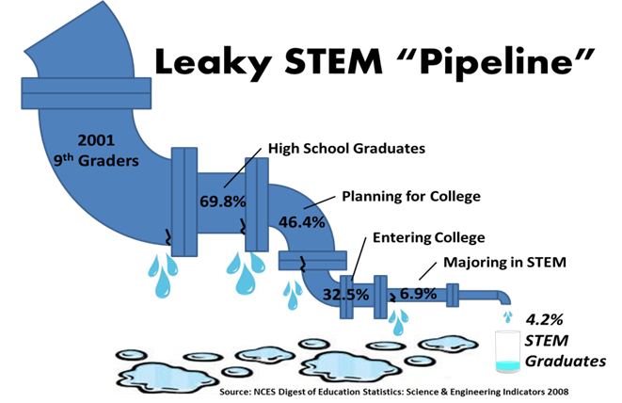
The Problem

Slide 7
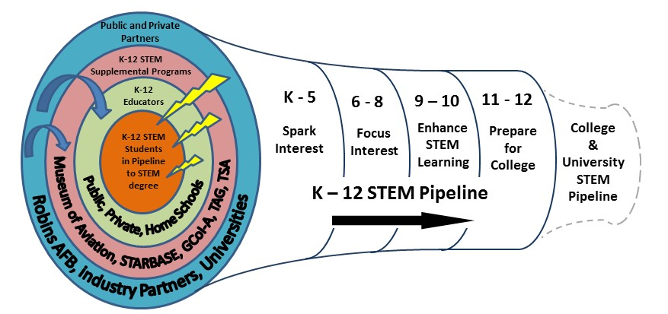
The Solution

Slide 8
STEM Mission
Encourage development of science and math skills which are essential to success in technology and engineering
  Increase awareness of education and career opportunities in STEM, industry and government
  Special emphasis on under-represented groups, minorities and females, in STEM programs
Coordination of volunteers to serve as role models, mentors, coaches, judges at area events/competitions
Collaboration on STEM with existing STEM outreach programs, school boards, charter schools, universities
Manage execution of AF STEM funds to promote STEM education, programs, and awareness of Air Force; Sponsor clubs, camps, programs w/STEM focus in Middle GA

Slide 9
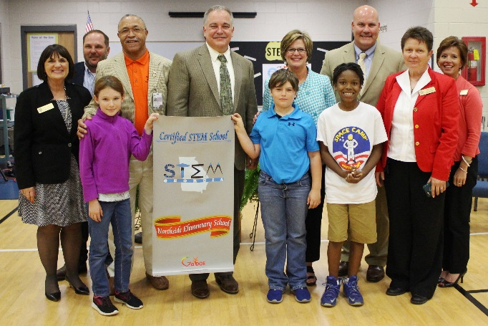
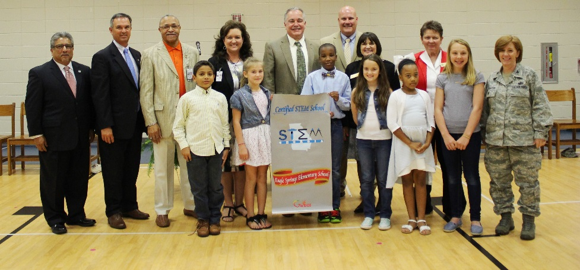
GA STEM Certified Schools
Georgia Department of Education – STEM Certified School
  Involves entire school, teacher education, 3+ years
  Collaboration of curricula, school-wide project
  Multiple visits by Certification Assessment Team
Local STEM Certified Schools
  Northside Elementary, Eagle Springs Elementary Schools
  Thomson Middle, Huntington Middle Schools (in progress)

Slide 10
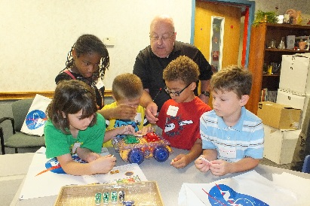
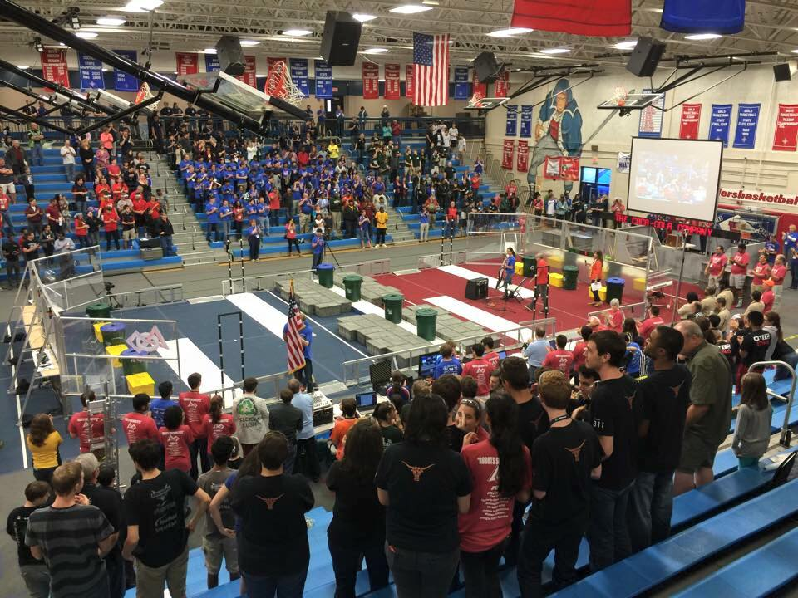
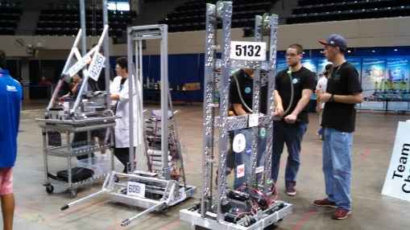
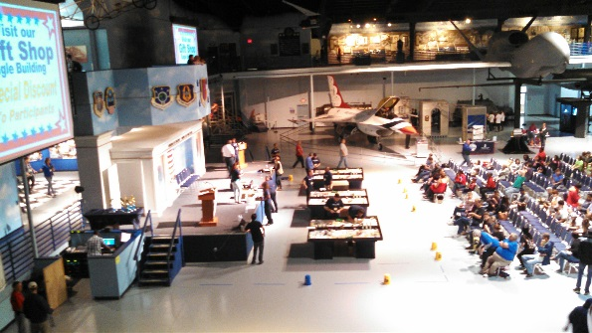
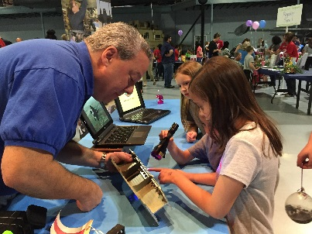
STEM Robins Style
Support for local schools for GA STEM Certification: base tours, briefings for teachers/counselors
Speakers, hands-on for Career Days, Family STEM Nights
Judges for local and district science fairs, Technology Student Association, and other competitions
Volunteers for FIRST Robotics events, prepare DoD grant requests for area FLL, FTC, and FRC teams

Slide 11
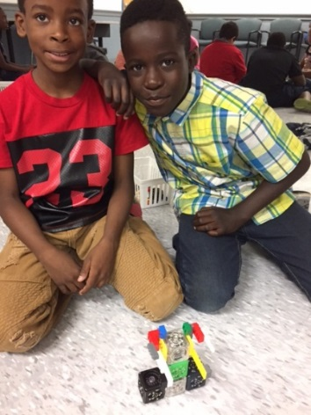
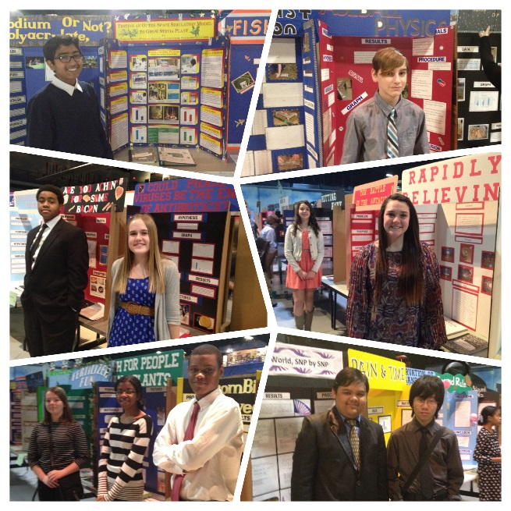
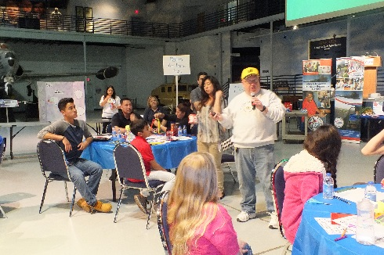
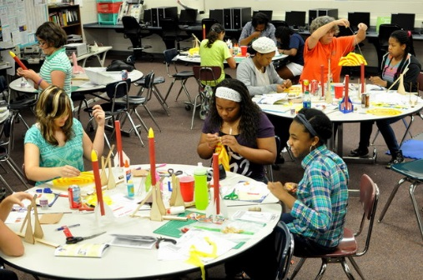
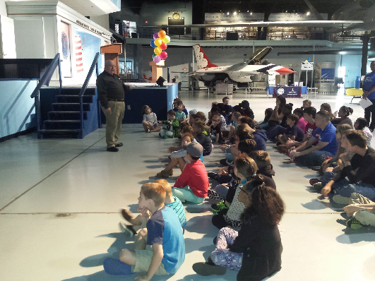
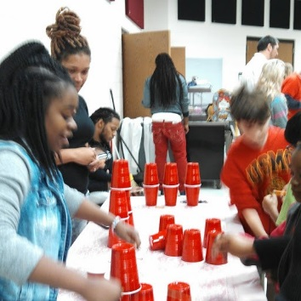
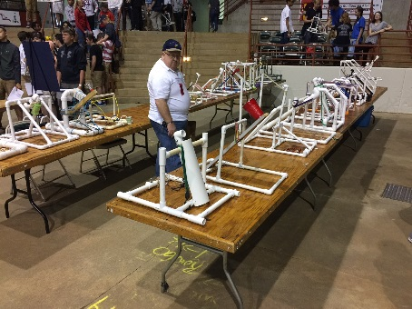
STEM Robins Style
Judge for GA Junior Science and Humanities Symposium (DoD)
Industry Partner for STEM Fellows (grant from AFRL)
Serve on Advisory Committees, area schools and universities; collaboration with Middle GA RESA, STEM Alliance, DAU
“Find out what’s working and join them”

Slide 12
STEM Summits
Summit 1.0
  Jan 2014, Robins Conference Center
  All stakeholders
Summit 2.0
  Sep 2014, Museum of Aviation
  Focus on K-12
Summit 3.0
  Mar 2015, Atlanta (GT campus)
  All stakeholders

Slide 13
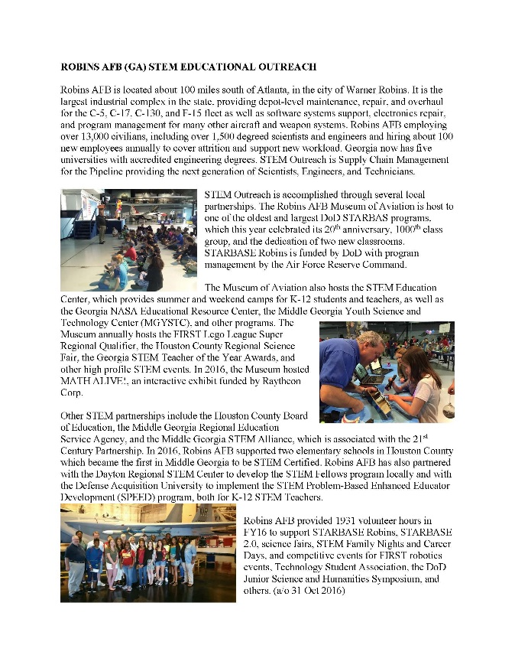
AF STEM 2016 Annual Report
Robins AFB provided 1931 volunteer hours in FY16 to support STARBASE Robins, STARBASE 2.0, science fairs, STEM Family Nights and Career Days, and competitive events for FIRST robotics events, Technology Student Association, the DoD Junior Science and Humanities Symposium, and others.

Slide 14
Partners
Houston County Board of Ed (HCBE) STEM Committee
  Support STEM Certification, events
Houston County Career Academy (HCCA), advisory committee
  Dual-enrollment degree programs
  Hosts FireStarter FabLab
Middle GA STEM Alliance (MGSA)
  21st Century Partnership and community STEM partners
Middle GA Regional Education Service Agency (MGRESA)
  State-chartered, supports teachers
  STEM Fellows (grant from AFRL)

Slide 15
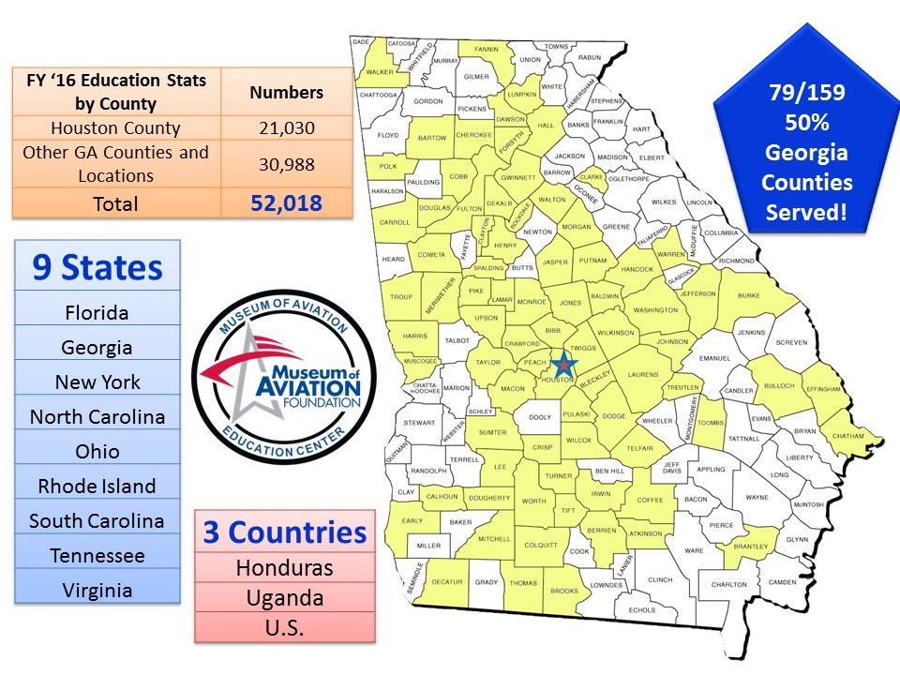
Museum of Aviation

Slide 16
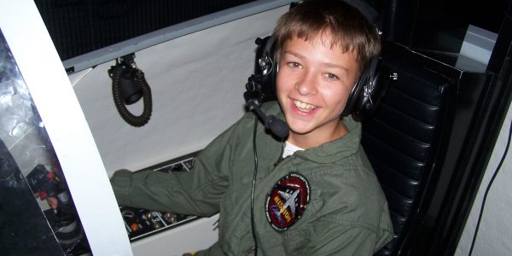
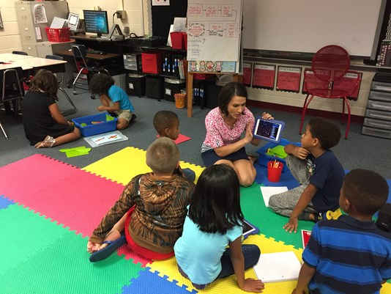
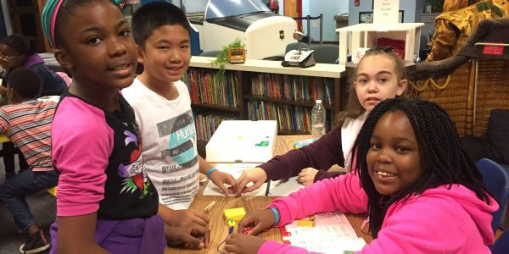
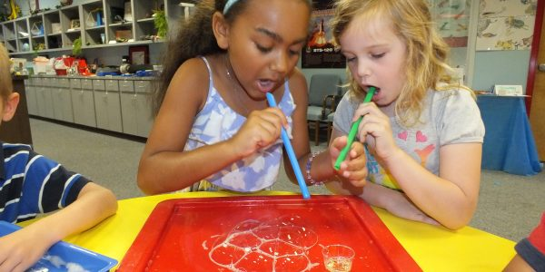
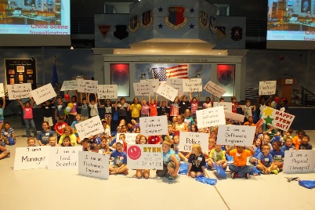
Museum of Aviation
National STEM Academy
  ACE, ACE on the Go; Wonder Wings, WW on the Go
  Mission Quest – ATC and Flight Simulators
  NASA Educator Resource Center
  GA Youth Science and Technology Center (GYSTC)
  Homeschool STEM Program
  Camps/Events: GA Kid’s STEM Day, Young Astronaut’s Day
Cyber Patriot (with AFA)
WWII Aviation History, Aviation Heritage

Slide 17
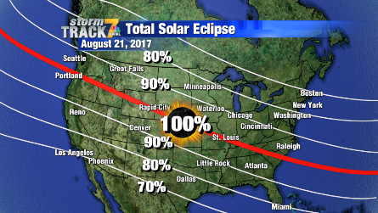
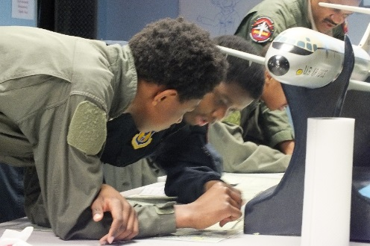
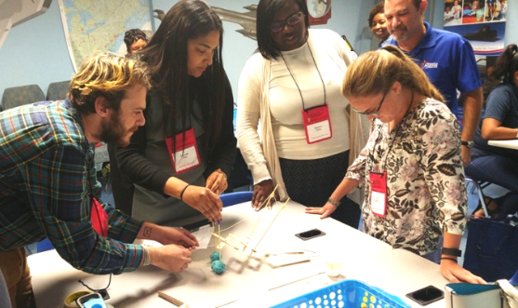
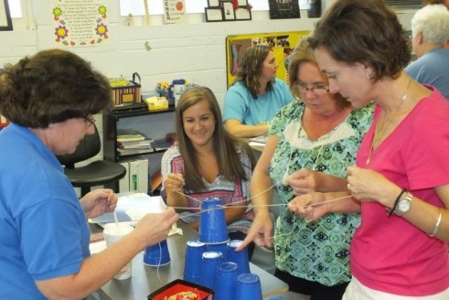
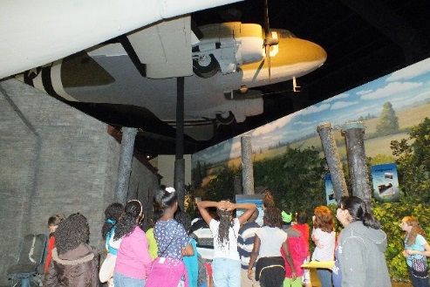
Museum of Aviation
Teacher workshops:
  6th Annual GA NASA STEM Conference, Teacher of the Year
  Lunar & Meteorite Sample Certification
  Aerospace
  Robotics and Coding
  Women in STEM
  Space Life Sciences
  STEM & the Systems Engineering Model (with DAU)
  NASA Optics – Solar Eclipse 2017

Slide 18
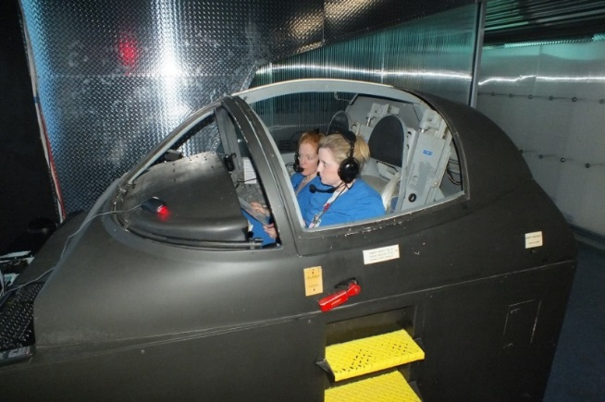
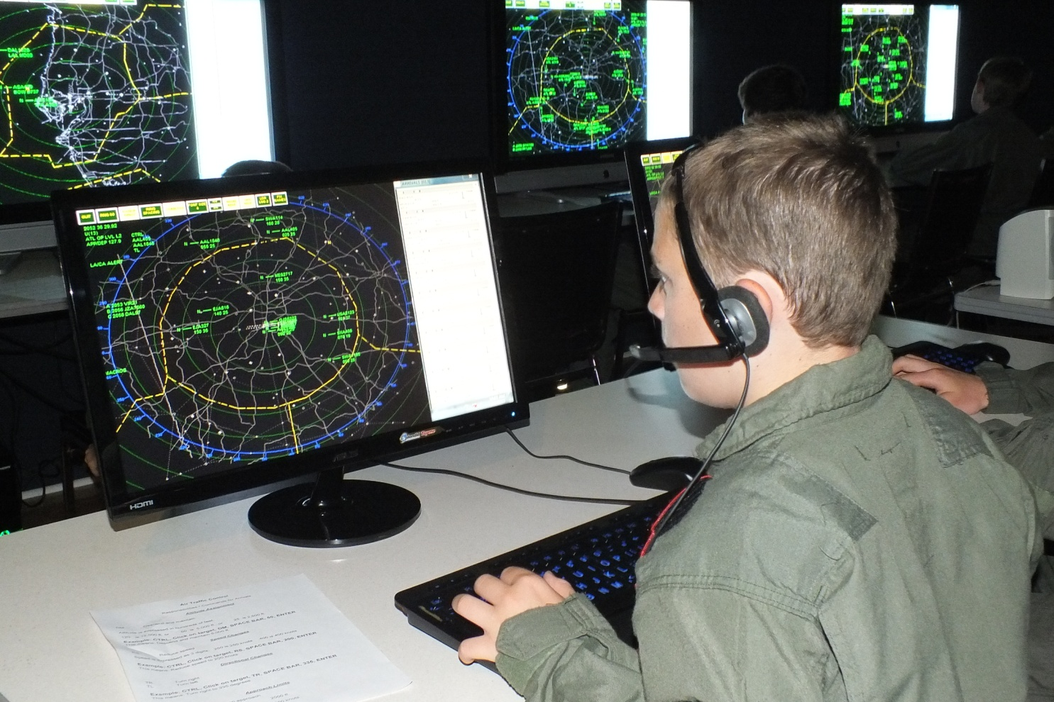
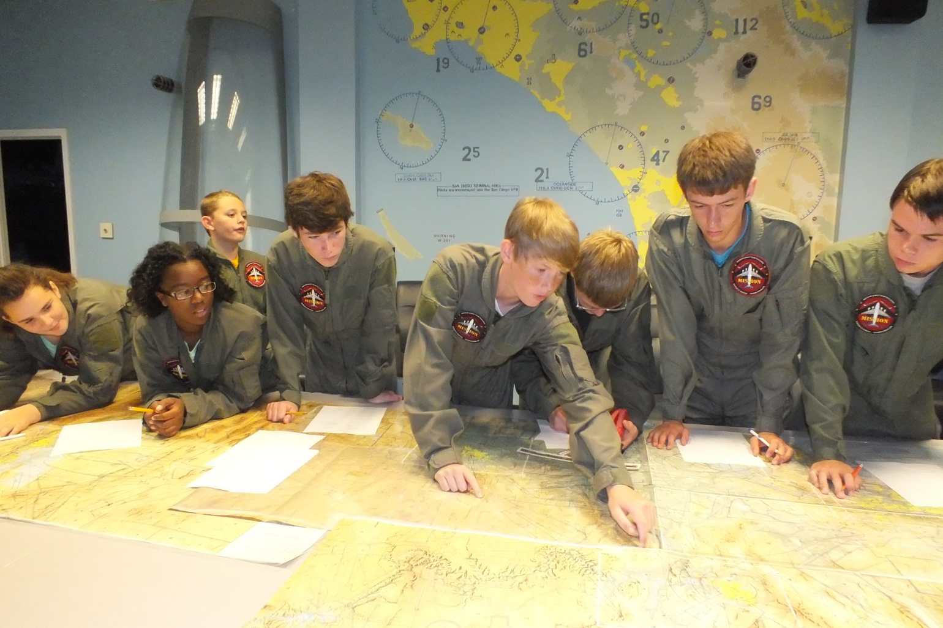
Museum of Aviation
Assessment/Metrics:
  Mission Quest: Before – 48%, After – 73%
  ACE: Before – 66%, After – 87%
  WWII Tours – Before 60%, After 87%
  NASA Teacher Training – 138 of 146 educators rated event very effective for increasing student interest in STEM

Slide 19
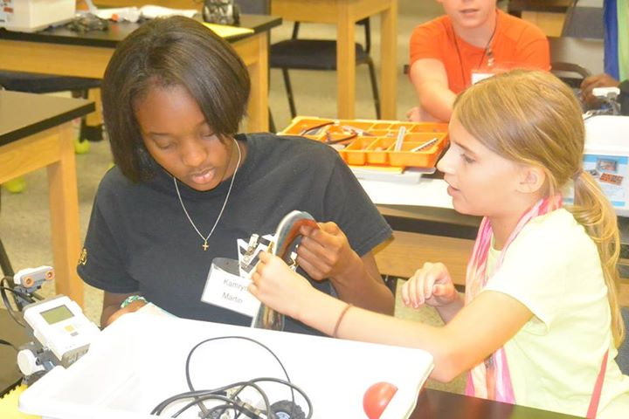
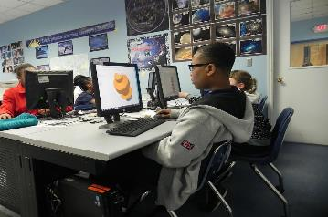
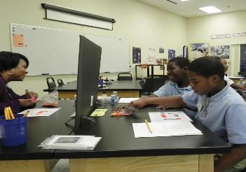
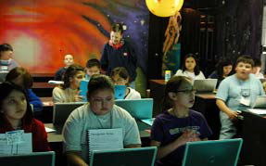
STARBASE Robins
Wesley Fondal, Jr – Director of DoD STARBASE Robins
  STARBASE Robins began 1996, has served over 20K students, over 1000 classes, over 450K contact hours
  Classes 25-hours over 5 days, certified teachers and volunteers; pre/post testing shows positive impact
  Curriculum includes physics, chemistry, technology, engineering, math applications, and STEM career guidance
  Only 5th grade program to include CAD and 3-D manufacturing

Slide 20
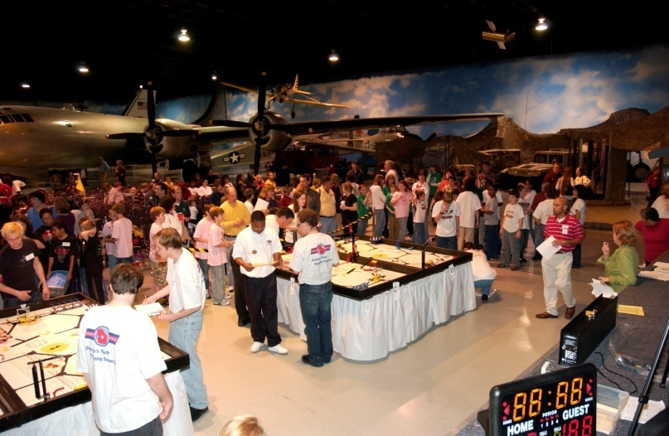
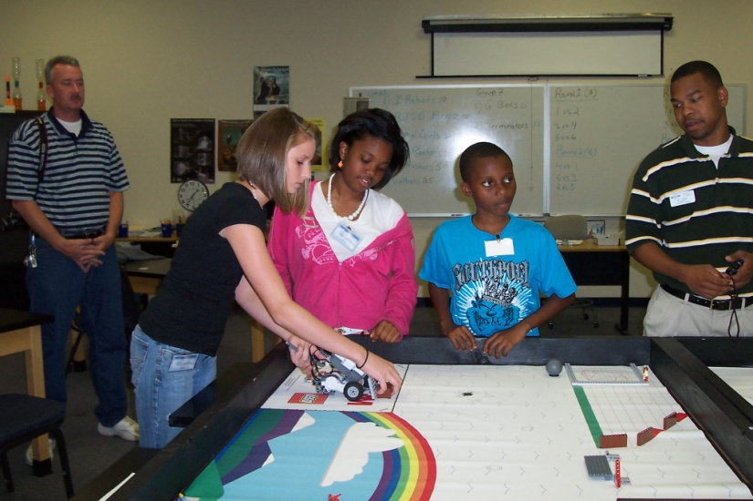
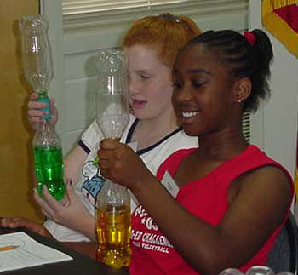
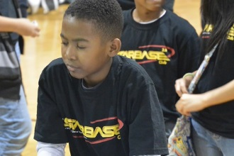
STARBASE Robins
Focuses on under-represented groups in STEM, schools with low academic performance scores, socio-economically disadvantaged
Summer academies in robotics and engineering
  Girl STEM Academy, Agricultural STEM Academy
Hosts FIRST Lego League state qualifier
STARBASE 2.0 afterschool mentoring program

Slide 21
Get Involved!
Coach/mentor for FIRST Robotics team
Coach/mentor for STARBASE 2.0 afterschool club
STEM hands-on demonstration at school
  Family STEM Night
Career Day talk at school, STARBASE
Judge for science fair, Jr Science & Humanities Symposium
Volunteer for STEM event – Museum, school
  Coach, Mentor, Instructor, Cat-herder
Industry Partner for STEM Fellows

Slide 22






Questions?
For more information, visit
  www . MuseumOfAviation . org
  www . STARBASErobins . org
  www . STEMgeorgia . org
  www . AFSTEM . org
  Or, find them on Facebook

Slide 23
BACKUP Slides

Slide 24
Topics
AF STEM Execution at Robins AFB – Jamie Cook
Museum of Aviation, STEM Education Center – Melissa Spalding
STARBASE Robins – Wesley Fondal
Walking Tour

