Slide 1


Robins AFB
Mr. Otis Hicks
Director, 78 Civil Engineer Group
78th Air Base Wing
Robins AFB, GA
November 2010
Notes:
I am going to give you guys some background on Robins AFB and then tell you a about our Program in Civil Engineering.

Slide 2
Overview
Robins AFB Mission
Military Construction (MILCON)
Sustainment, Restoration, and Modernization (SRM)
Depot Maintenance Activity Group (DMAG)
Operations and Maintenance (O&M)
Indefinite Deliverable/Indefinite Quantity (IDIQ) Contracts
Questions
Notes:
This is an overview of my presentation today. I will discuss some background about Robins, the ABW and the CEG. Then I will move on to our program beginning w/ MILCONs, then SRM, our DMAG Program, O&M and finally a list of our IDIQ contracts.

Slide 3
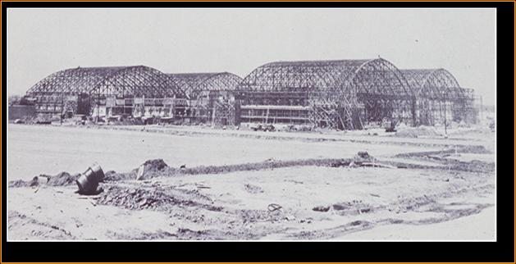
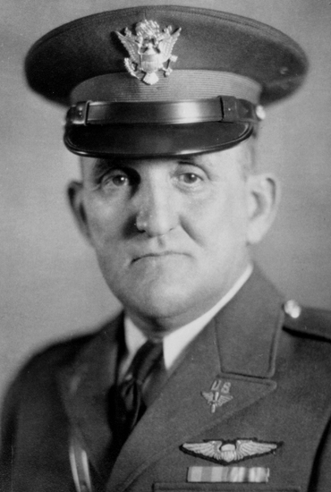
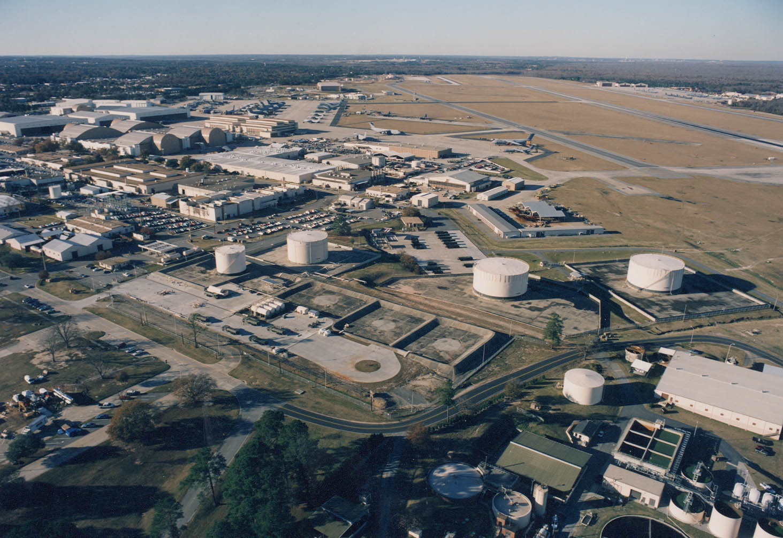
The Base...
Began in 1941 as an Army
Air Depot
Named in Honor of Brig Gen Warner Robins
Located on 8,215 Acres of Land
Longest Runway in Georgia – 12,000 ft
23,000 Employees
Annual Payroll Over 1.2 Billion
$4+ Billion Economic Impact
Across Georgia
Georgia’s Largest Industrial Complex
Notes:
- Depot activities began here in 1941 when the base was established as Army Air Depot.
At the time, the city was named Wellston. General Warner Robins was a former Commander of the Material Division, which preceded today’s AFMC. He was a mentor of Col Charles Thomas, who as assigned the job of building this base. Col Thomas had been an aide to General Robins and, in his honor, pushed to have the base named after the general. Since the convention for naming the Logistic Centers after the name of the town it was in, Col Thomas petitioned to the city of Wellston to change its name to Warner Robins, which it did.
- The base is located on 8,200 acres of land.
We have the longest runway in the state at 12,000 ft
The base has a huge economic impact on the state of Georgia of over $4B per year.
Robins is Georgia’s largest industrial complex – so when you hear that “everyone works on base” it’s because they do!!

Slide 4
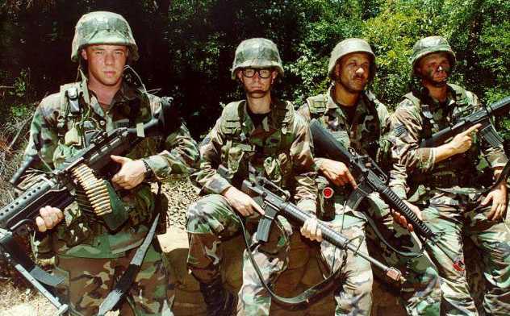
Mission at Robins AFB
Depot level maintenance
  F-15 Eagle
  C-130 Hercules
  C-5 Galaxy
  C-17 Globemaster
Avionics manufacture/repair
Weapons System software testing
Aircraft/helicopter/drones/ missile components
Product/Logistics Support
Force deployment
50 Associate Units
Notes:
Depot level maintenance
F-15 Eagle
C-130 Hercules
C-5 Galaxy
C-17 Globemaster
Avionics manufacture/repair - aircraft worldwide
Aircraft/helicopter/drones/missile component design/development & manufacture/repair
Another large part of our mission at this ALC is comprised of Purchasing and Supply Chain Management, Product Support/Sustainment and Force Deployment. Not only do our people themselves deploy, we have supported deployments of a multitude of forces during Operation Iraqi Freedom,
We also have 39 associate Units like HQ AFRC, 5th CCG, 116th Joint Stars ACW, and the Defense Logistics Agency (DLA)

Slide 5
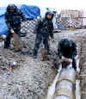
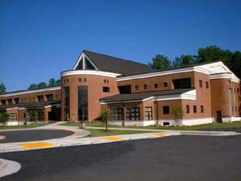

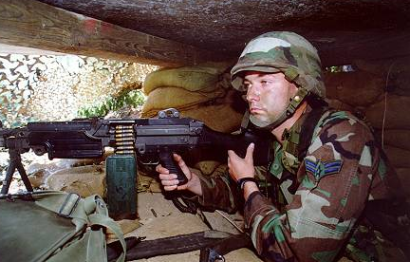
78th Air Base Wing
We provide trained, ready Airmen to support
Air Expeditionary Forces and world-class base operating support to Robins Air Force Base
Notes:
The 78th Air Base Wing is responsible for all support services and facilities on Robins AFB, the first and foremost part of their mission is to provide combat ready war-fighting forces for deployment to war-fighting commands around the world. Additionally, the 78th Air Base Wing provides services for the Warner Robins Air Logistics Center and the entire Robins Air Force Base community. The 78th ABW is led by Wing Commander Col Carl Buhler who is also designated as the Installation Commander.

Slide 6
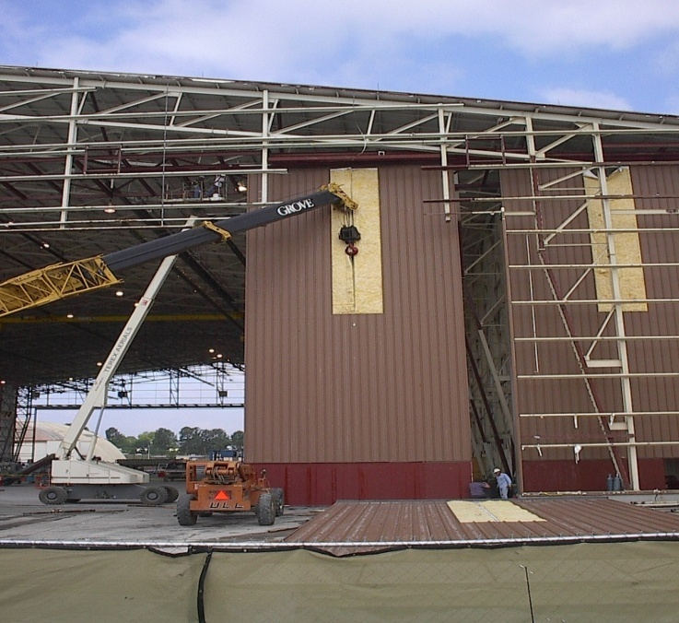
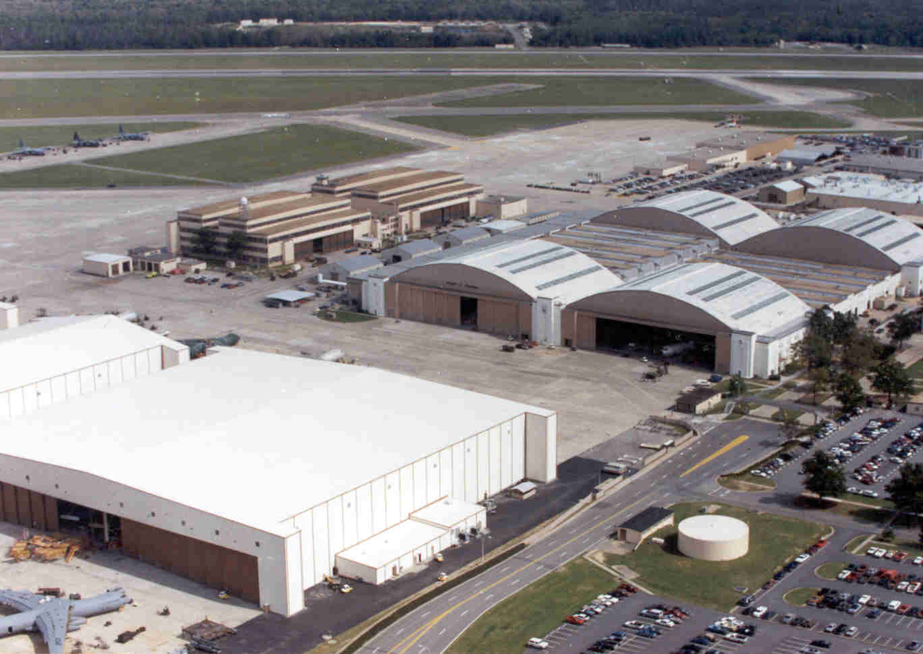
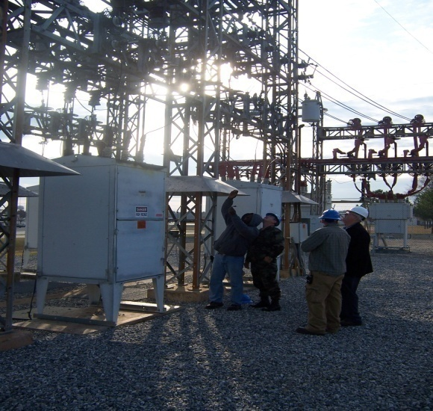
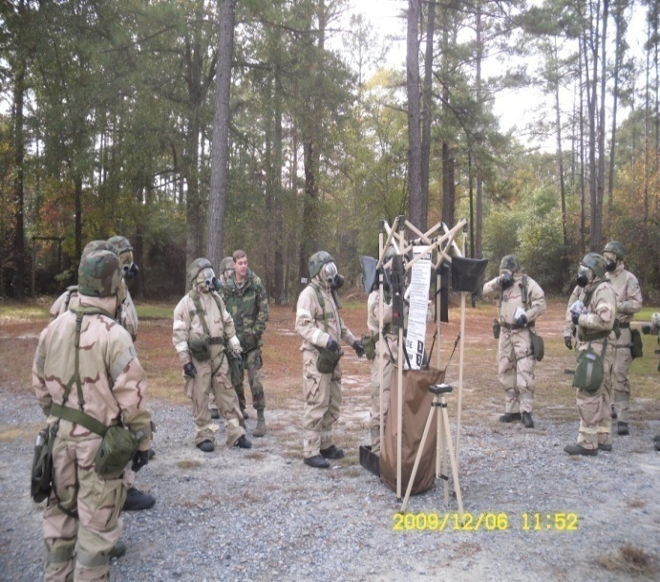
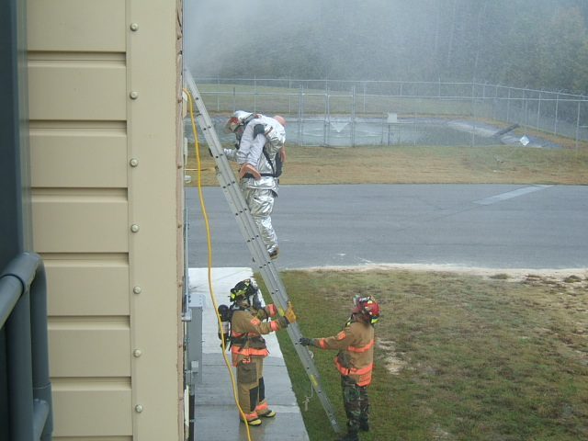
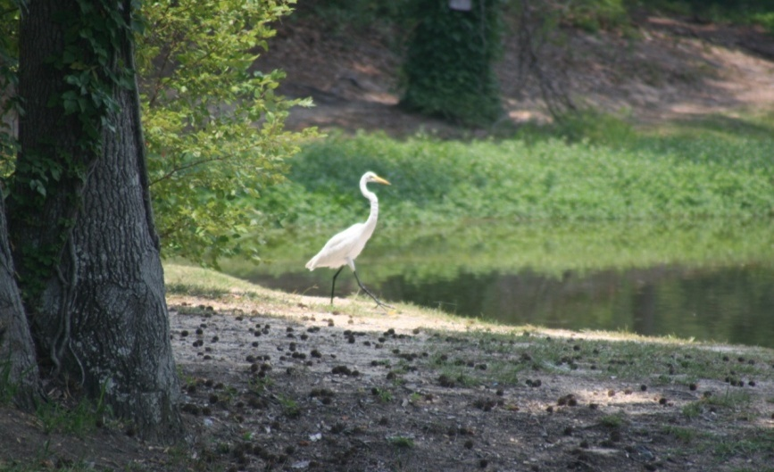
78th Civil Engineer Group
Notes:
The 78th Civil Engineer Group (CEG) provides:
Engineering and design
fire protection services
emergency management
maintains real property
accomplishes alteration and new construction
protects and conserves natural resources
manages contract services
maintains facilities and infrastructure
Manages privitized military family housing units and dormitory rooms

Slide 7
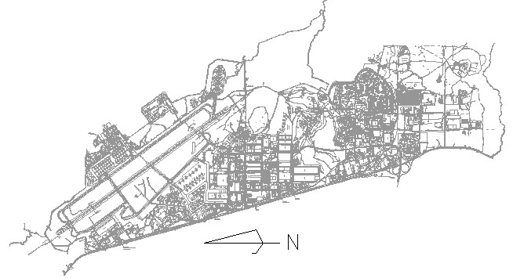
MILCON Projects
Under Construction
ADVANCED METAL FINISHING FACILITY
9113 SM/98100 SF
COST - $30,000,000
ECD – MAR 2012
AIRCRAFT COMPONENT
REPAIR FACILITY
5669 SM/61020 SF
COST - $14,700,000
COMPLETED
COMMAND POST
1282 SM/13800 SF
COST - $5,000,000
ECD – DEC 2010
BRAC
MARINE CORPS HELICOPTER
HANGAR (3877 SM/41731 SF)
5415 SM/ 58286 SF
(TOTAL RENOVATION)
COST - $27,460,000
COMPLETED
116th AVIONICS FACILITY
1858 SM/20000 SF
COST - $5,250,000
ECD - MAR 2011
BRAC DDC 2
DLA GENERAL PURPOSE
WAREHOUSE
15568 SM/167575 SF
COST - $24,200,000
ECD – FEB 2011
SOFTWARE SUPPORT FACILITY
6503 SM/70000 SF
COST - $21,000,000
COMPLETED
CARGO AIRCRAFT HANGAR
9000 SM/97000 SF
COST - $24,100,000
ECD – JUN 2011
HOT CARGO PAD
14500 SM/156067 SF
COST - $6,200,000
ECD – SEP 2011
Notes:
These are the locations of the six MILCONs we currently have under construction. Please note the three blue dots are locations of the Marine Helicopter Hangar (a FY07 BRAC Project), the Aircraft Component Repair Facility (FY07 Transformation project), and Software Support Facility (Congressional insert) that are MILCONs completed this year.

Slide 8
MILCON FYDP 12-15
(All currently unfunded)
PRI | ORG | PROJECT NO UHHZ | FY | FYDP PROJECT TITLE/DESCRIPTION | COST ($000)
1 | ABW | 073011 | 13 | ADAL GATE 5 | >$15,000
2 | ABW | 013009 | 14 | SECURITY FORCES FACILITY | >$20,000
3 | ABW | 063000 | 15 | CONTROL TOWER | >$15,000
ORG | PROJECT NO UHHZ | FY | 12/13 Call PROJECT –PART OF THE AF FAMILY FITNESS CENTER PROGRAM- TITLE/DESCRIPTION | COST ($000)
ABW | 053001 | 12/13 | ADAL PHYSICAL FITNESS CENTER | >$5,000
Notes:
There are three projects in the FY 12-15 FYDP – The Gate 5 project will convert Gate 5 into a commercial gate. We also have a Security Forces Facility and a Control Tower programmed.
AFMC prioritization is 12 for Security Forces, 17 for Gate 5, and 31 for the C-17 Hangar.
In addition we have a Fitness Center project in the 12/13 call for Fitness Centers.
The Fitness center is 38th in priority for AFMC.
Air Force has not completed their priority yet.

Slide 9
MILCON Projects
FYDP 12-15
FY12/13
PHYSICAL FITNESS CENTER
FY15 – 063000
CONTROL TOWER/BASE OPS
FY14 – 013009
SECURITY FORCES FACILITY
FY 13 – 073011
ADAL GATE 5
(MLK) MODIFICATIONS
Notes:
Here are the locations of the three MILCONs in the FYDP and the Fitness Center.

Slide 10
Projected Priority 1-n List FY10
FY 11 Prioritization in Progress
PRI | ORG | PROJECT NO UHHZ | PROJECT TITLE/DESCRIPTION | COST ($000)
1 | ABW | 073011 | ADAL GATE 5 * | >$15,000
2 | ABW | 013009 | SECURITY FORCES FACILITY* | >$20,000
3 | ABW | 063000 | CONTROL TOWER* | >$15,000
4 | AMXG | 073001 | C-17 MAINTENANCE HANGAR, B/81/82/83 | >$25,000
5 | ACSG | 103002 | C2ISR (RPL B/350) | >$100,000
6 | EMXG | 073008 | CONSOLIDATED PMEL/GYRO FACILITY | >$50,000
7 | SMXG | 093001 | SOFTWARE SUPPORT FACILITY EXPANSION | >$10,00
8 | CMXG | 093004 | A/C FIRE BOTTLE FACILITY (Siting in Progress) | >$15,000
9 | ABW | 053015 | REFUEL VEHICLE MAINT FACILITY | >$10,000
10 | ABW | 983002 | UPGD DOMESTIC SEWAGE | >$10,000
11 | DLA | 013011 | RPR/UPGD FUEL HYDRANT SYS, B/2089 | >$15,000
12 | DLA | 013010 | RPR/UPGD FUEL HYDRANT SYS, B/39 | >$15,000
13 | MXSG | 093005 | CHEMICAL & MATERIAL TESTING LAB | >$15,000
14 | ABW | 023000 | ADAL COMMUNICATIONS FACILITY | >$10,000
15 | ABW | 053001 | ADAL PHYSICAL FITNESS CENTER | >$5,000
 |  |  | * Projects in FYDP 12-15. Reference Previous Slide Map Location
Notes:
This shows the top 15 projects in our current MILCON program. We are in the process of prioritizing the program using HQs AFMC Methodology.

Slide 11
MILCON Projects
Other MAJCOM
023012, 093006, 073004, 073003,
073005, 073007
AFRC READINESS/TRG FACILITY - FUNDED
HQ COMPLEX INFRASTRUCTURE
HQ COMPLEX FACILITY (BLDG 1)
HQ COMPLEX FACILITY (BLDG 2)
HQ COMPLEX FACILITY (BLDG 3)
HQ COMPLEX FACILITY (BLDG 4)
983006P1, 983006P2, 003004,
993009, 013001, 033001
689th CCW, 5TH CCG FACILITIES
51st CCS Warehouse Facility
52nd CCS Operations Facility
53rd CCS Operations Facility
54th CCS Operations Facility
54th CCS Operations Facility
689th CCW HQ
Notes:
These are the locations for MILCONs from other MAJCOMs. Both the 689th and AFRC have campus concepts which will house their operations/organizations all in one location.

Slide 12
Facility SRM Execution
Notes:
This is what our SRM program looks like historically and our projection thru FY12. Please note the jump in FY09 was due to the $36M we received in Stimulus or American Recovery and Reinvestment Act.

Slide 13
FY11 Top 20 SRM Program
24
TITLE | ($000)
RPR TILE STEAM/SAUNA WAITING RMS, GYMNASIUM, B/826 | <100
RPR/RENV RESTROOMS, BOWL CEN, B/908 | <250
RPR/UPGRD RESTROOM/SHOWER STALLS, WST TRMT BLDG, B/315 | <100
RPR/RPL HVAC IN KITCHEN, OPEN MESS, NCO, B/956 | <100
RPR/RPL CHLORINE CONTACT CHAMBER, WST TRMT BLDG, B/371 | <500
RPR/RENV INTERIOR/RPR HVAC SYS, BASE PERSONNEL OFC, B/767 | 1,000-2,500
RPR/UPGRD HVAC SYS, TWR CON, B/37 | <50
RPR/RPL HOOD DUCTS//EXHAUST FANS, B/377,1021,946,943 & 2062T | <500
RPR/RPL HVAC SYS, IND WST TRMT&DSPL, B/141 | <250
RPR/RENOVATE B/1555 | 500-900
Notes:
Here and on the next slide is a list of the Top 20 SRM projects

Slide 14
FY11 Top 20 SRM Program (cont.)
24
TITLE | ($000)
RPR/UPGRD ELEC SYS, AFCS MAINT FCLTY, B1364 | <100
RPR/RPL FALL ZONE MATERIAL, CHILD CARE CEN, B/943 | <50
RPR/RPL ADDRESSABLE FIRE ALARM SYS, MULTI | <1,000
PR/UPGRD ELECTRICALWIRING, LOG FCLTY DEP OPS, B/350 | <10
RPR/RPL AHU ACTUATORS, DORM AM PP/PCS-STD, B/756 | <100
RPR/RPL ROOF, VEH MAINT SHOP, B/655 | <50
ENERGY STUDY MODEL ANALYSIS, B/826, 827, 905 & 1555 | <50
RPR/RPL HVAC SYS, AFCS MAINT, FCLTY, B/953 | 1,000-2,500
RPR/RELOC BITS OFFICE FR B/300 TO P.O. B/910 | <25
RPR/UPGD CUSTOMER R/R, RESTAURANT BASE, B/166 | <25
Notes:
Here is a list of the SRM projects

Slide 15
FY11 DMAG Minor Construction Program
PROJECT DESCRIPTION | ($000)
Cnst Depot Ramp High-Mast Lighting | 500-700
Cnst Purge Station Admin Facility | 500-750
Cnst Acft Maint Training Pad | 500-750
Cnst NDI Storage Facility | 500-750
Cnst Component Repair Storage Facility | 500-750
Cnst First Article Test (FAT) Storage Facility | 500-750
Cnst Apron/Canopy | 500-750
Notes:
This is our FY11 DMAG minor construction projects. We currently are in the process of getting the design completed for the first five and have just started working the last two. The 402nd Maintenance Wing manages these funds and prioritizes the minor construction program. 78 CEG manages the contracting and construction for these projects.

Slide 16
FY11 DMAG Maintenance & Repair Program
ORG | PROJECT DESCRIPTION | ($000)
 | Mnt/Coat Barrel Roofs, Bldg 125 | 500-1000
 | Rpr Roof, Bldg 321 | 750-1500
 | Rpr Compressed Air System | 1500-3000
Notes:
This is the FY11 Maintenance and Repair program for DMAG funded projects. Again 78 CEG works with the 402nd MXW to contract and construct their prioritized projects.

Slide 17
FY11 O&M Program
ARCHITECT-ENGINEER (A-E) Approximate Total Value = $70M
A&E Design
Air Quality Program Support
Water Program Support
Conservation Program Support
Environmental Restoration Program Technical Support
Environmental Management System & Geographic Information System (GIS) Support
Pollution Prevention Weapon Systems Support
National Environmental Policy Act (NEPA) Support
Toxics Program Support
SERVICES
Refuse
Custodial
Recycling
Grounds Maintenance
Paving
Roofing
Ground Water Treatment System Remedial Action
Greater Base Industrial Area Operation of Air Sparge/Soil Vapor Extraction Systems
Ground Water Monitoring for Remedial Actions
Environmental Incident Response for Spills
Tank Program Support
Notes:
This is a snapshot of our O&M program which includes our service contracts and the environmental projects.

Slide 18
78 CEG IDIQ Contracts
Contract Date Exp Dollar Limit
AE Design Services (5) 2012 $19M
Carpet/Flooring 2015 $5M
Custodial Basewide 2014 $2M
Custodial DMAG 2014 $12M
Custodial, NISH 2012 $1M
Design-Build 2010* $28M
Grounds Maint 2014 $6M
Mech/Elec 2011* $25M
Paint 2011* $7M
Pavements Expired* $22M
Recycling 2010* $2.4M
Refuse 2016 $1M
Roofing 2013 $15M
SABER 2011* $50M
BOPEC D/B New* $45M
AE Environmental Services 2015 $36M
Approximate Value = $277M/5-yrs * New contract in process
Notes:
To wrap up these are our current and projected IDIQ contracts. Asterisks denote the contracts we are currently working to re-compete.

Slide 19
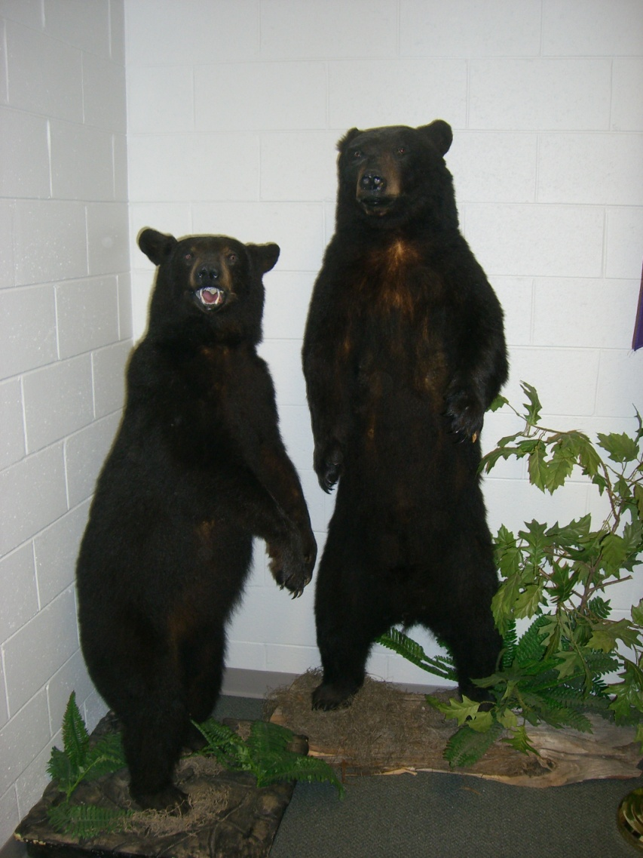
QUESTIONS?
Notes:
Does anyone have any questions?
19

